Slide 1


PROJECT ON
Title : Restaurant Market Analysis using Web Scraping and Exploratory Data Analysis
Presented By:
Mohammad Sohel
Batch No : 474
1

Slide 2
Preface:
INTRODUCTION
PROBLEM STATMENT
OBJECTIVE
TOOLS USED
WEB SCRAPING
DATA CLEANING STEPS
DATA VISUALIZATION
CONCLUSION
EXPERIENCE& CHALLENGES
FUTURE SCOPE
2

Slide 3
INTRODUCTION:
Online restaurant platforms provide valuable information about restaurant ratings, cuisines, prices, and promotional offers. However, this data is not available in structured form for analysis.
This project uses web scraping techniques to collect restaurant data from EazyDiner and applies exploratory data analysis to identify patterns in restaurant ratings, cuisine popularity, and pricing trends.
3

Slide 4
Problem Statment:
Restaurant platforms contain valuable information about ratings, pricing, cuisines, and offers, but this data is not available in structured form for analysis.
This project uses web scraping and exploratory data analysis to collect and analyze restaurant data in order to understand customer preferences, pricing trends, and restaurant market behavior.
4

Slide 5
Dataset information
Dataset: Restaurant_Market_Analysis
Source: EasyDinner.com
Description: Contains information about restaurant details and their prices in
Hyderabad,Chennai,Mumbai,Delhi
5

Slide 6







Tools & Libraries Used:
6

Slide 7
Web scraping
Collected Restaurent data from the Easy Dinner website using web scraping techniques.
Extracted key details such as Restaurant name, price, ratings, and Offers..
Used powerful Python libraries like BeautifulSoup and Requests for data extraction.Sent HTTP requests to fetch web pages.
Automated the process to gather large-scale real-time data efficiently.
Cleaned and structured the scraped data for EDA and visualization.
7

Slide 8
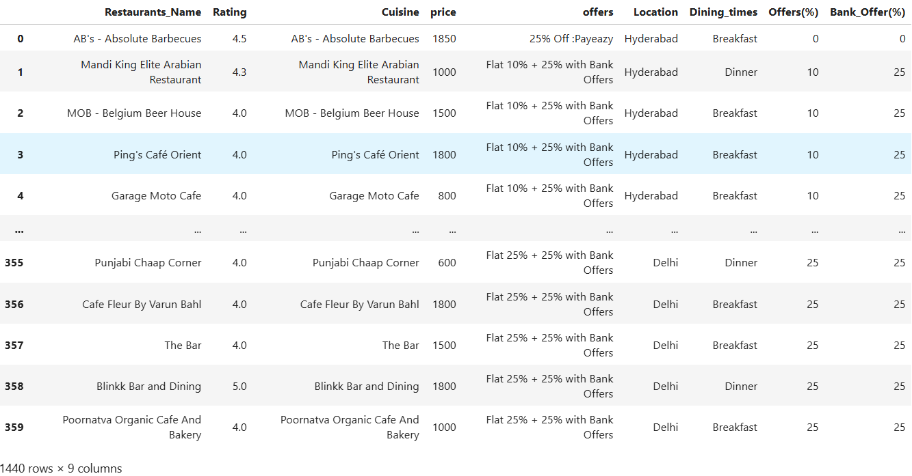
Raw dataset
8

Slide 9
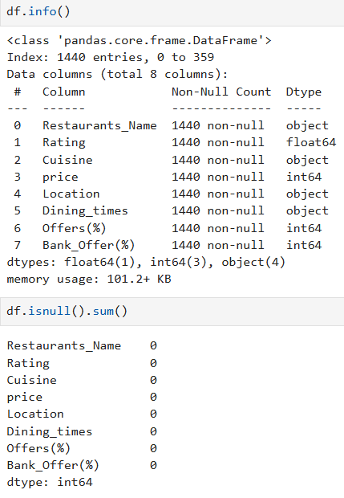
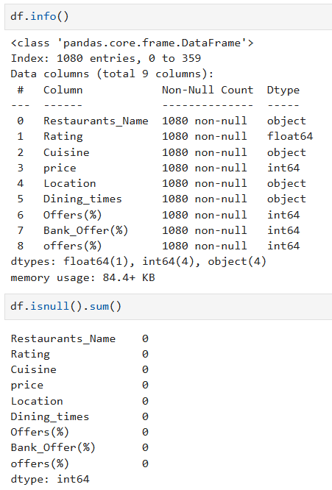
Data Cleaning Steps:
• Removed duplicate records to maintain data consistency.
• Treated missing values using suitable handling methods.
• Converted columns into correct data types (price, ratings,
Offers).
• Cleaned unwanted symbols like ₹, %, commas from
numerical data.
• Dropped irrelevant and redundant columns.
• Created a structured and analysis-ready dataset for EDA.
9

Slide 10
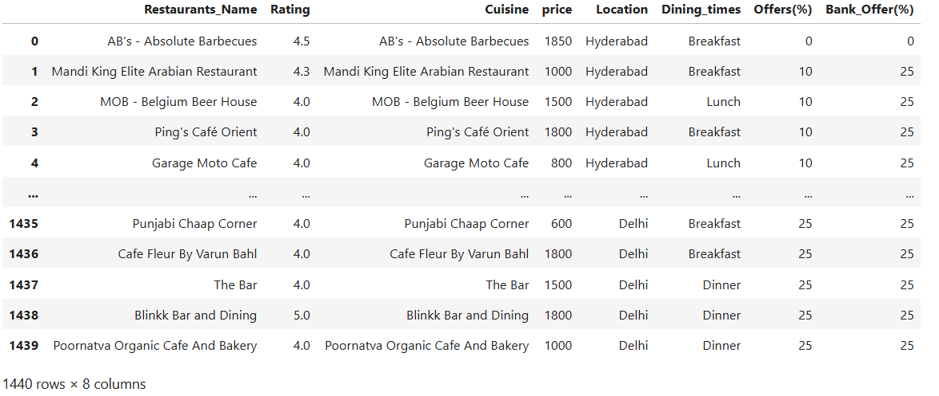
Dataset:
10

Slide 11
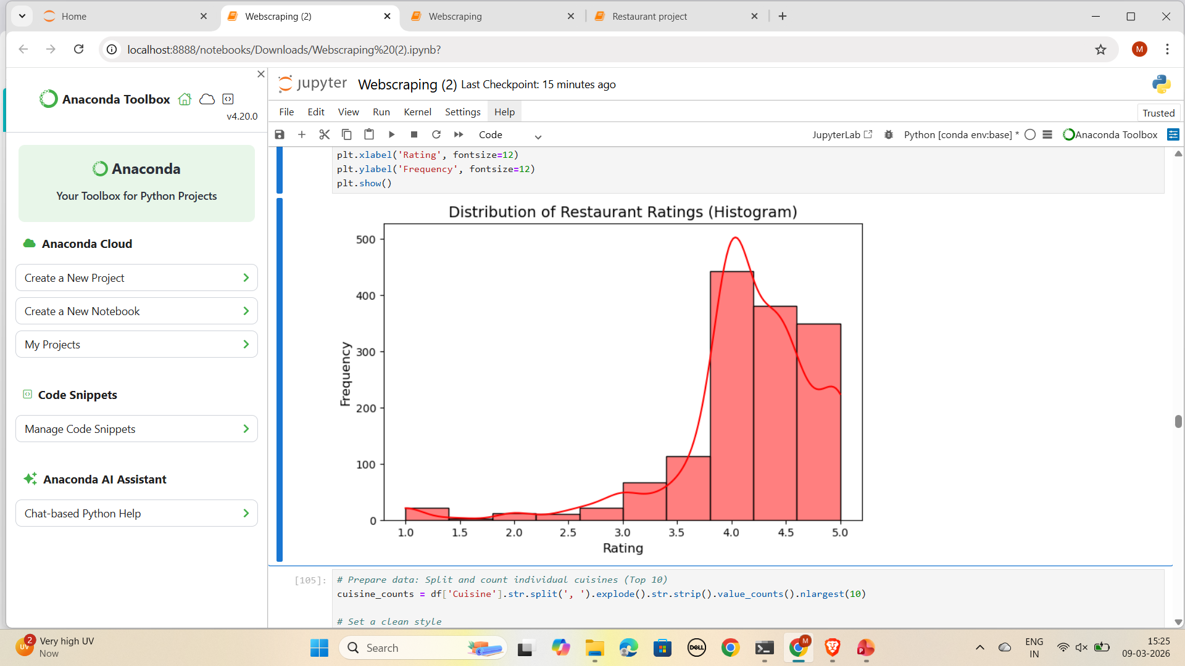
EDA - Univariate analysis
The majority of restaurants have ratings between 3.8 and 4.5, indicating generally positive customer satisfaction.
Very few restaurants fall below 3.0, suggesting that poorly rated establishments are rare in the dataset.
The highest density of ratings occurs around 4.0–4.2, which appears to be the average performance level for most restaurants.
The distribution slightly leans toward higher ratings, implying that most restaurants maintain relatively good service and quality.
11

Slide 12
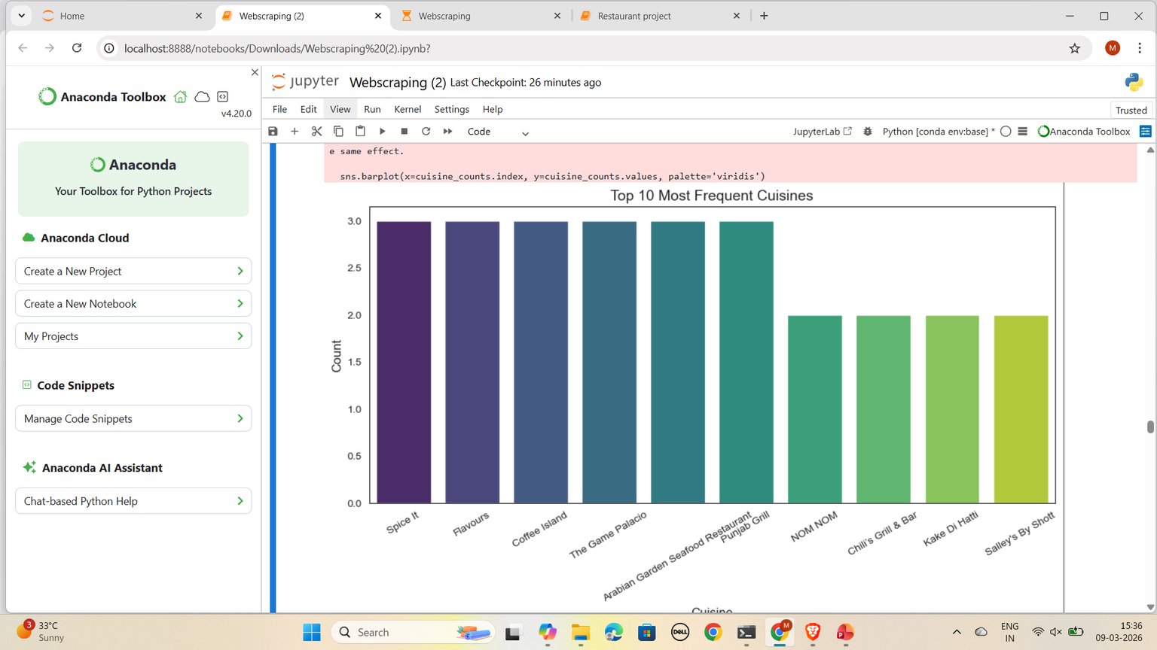
EDA - Univariate analysis:
A few cuisines appear slightly more frequently than others, indicating moderate popularity differences among the top cuisines.
Restaurants such as Spice It, Flavours, Coffee Island, and The Game Palacio appear among the most frequent categories in the dataset.
Several cuisines have similar counts, suggesting that customer preferences are fairly distributed across multiple cuisine types rather than dominated by a single one.
Some cuisines such as NOM NOM, Chili's Grill & Bar, and Kaké Di Hatti appear slightly less frequently compared to the top ones.
12

Slide 13
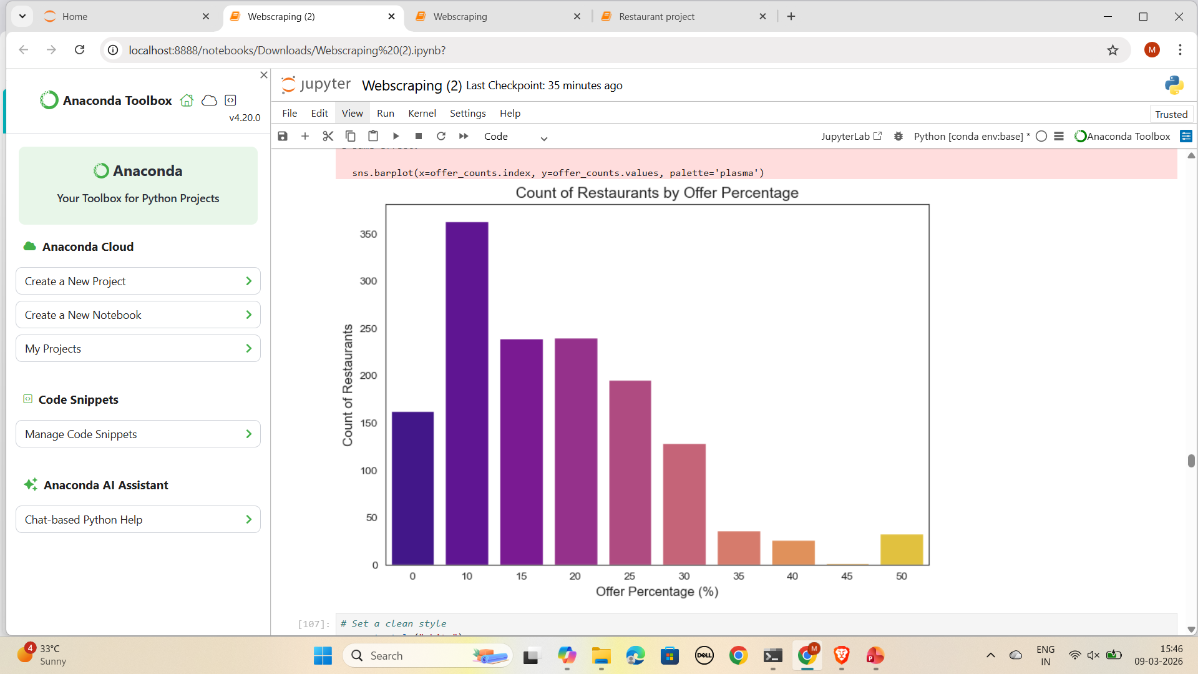
EDA - Univariate analysis
The majority of restaurants provide discounts between 10% and 20%, indicating that moderate promotions are the most common marketing strategy.
Higher discounts above 30% are much less frequent, suggesting that restaurants limit large discounts to protect profit margins.
The distribution shows that restaurants prefer smaller but more sustainable promotional offers rather than large discount campaigns.
13

Slide 14
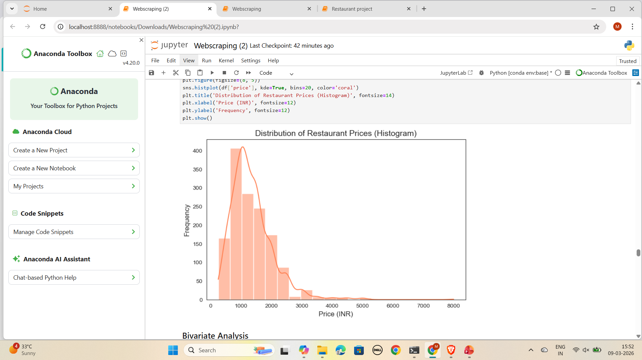
EDA - Univariate analysis
Most restaurants in the dataset fall within the ₹800–₹2000 price range, indicating that mid-range dining options dominate the market.
The price distribution is positively skewed, meaning there are only a few expensive restaurants compared to many moderately priced ones.
High-end restaurants costing above ₹3000 are relatively rare, suggesting that premium dining options represent a smaller portion of the overall restaurant landscape.
14

Slide 15
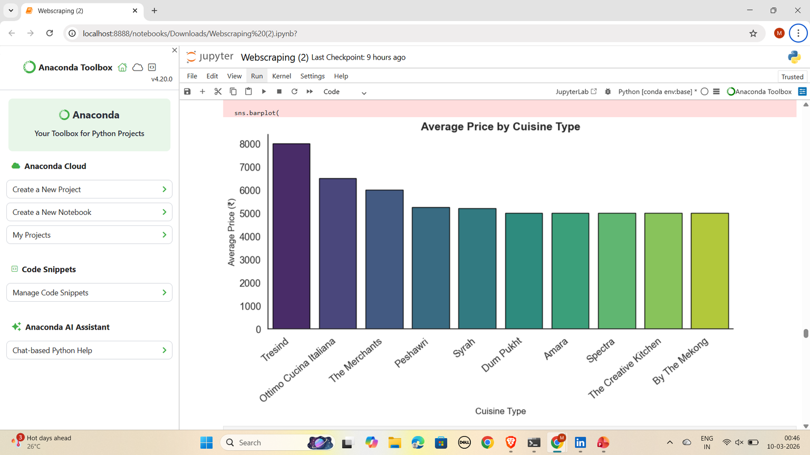
EDA - Bivariate analysis:
The bar chart shows the average price of restaurants across different cuisine types.
Tresind has the highest average price (around ₹8000), indicating it is a premium fine-dining restaurant.
Ottimo Cucina Italiana and The Merchants also have high average prices (above ₹6000).
Other cuisines such as Peshawri, Syrah, Dum Pukht, Amara, Spectra, The Creative Kitchen, and By The Mekong fall in the ₹5000–₹5300 range.
Insight:
15

Slide 16
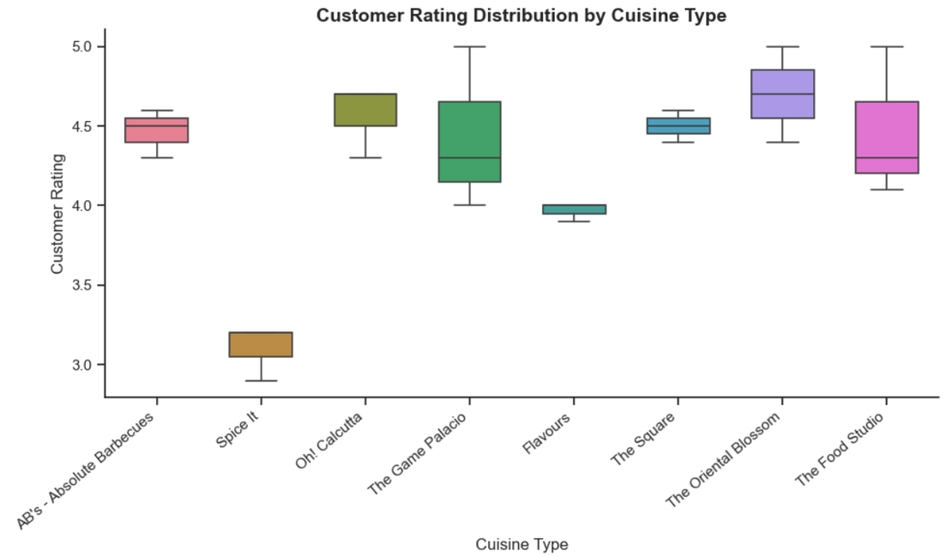
EDA - Bivariate analysis:
Most restaurants have ratings between 4.0 and 4.7, indicating generally high customer satisfaction.
Oh! Calcutta and The Square show consistently high ratings with very little variation.
Spice It has the lowest rating range (around 3.0–3.2) compared to other restaurants.
16

Slide 17
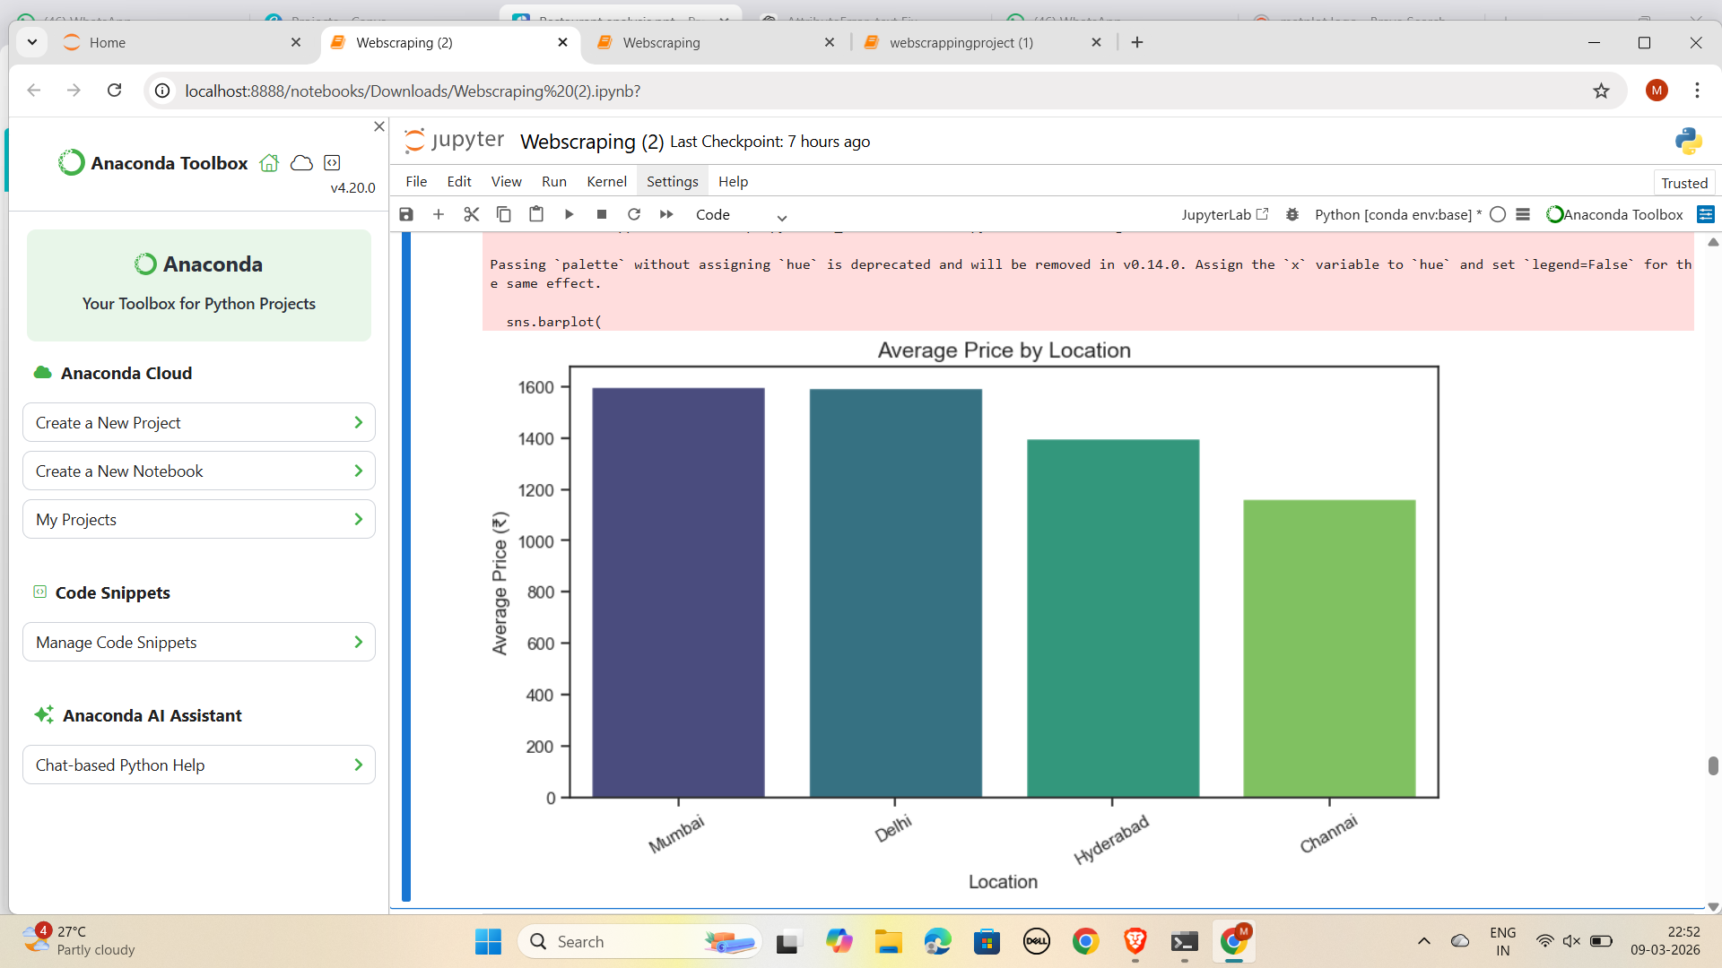
EDA - Bivariate analysis:
Major metropolitan cities such as Mumbai and Delhi tend to have higher restaurant prices, likely due to higher living costs and a stronger presence of premium dining establishments.
Hyderabad offers moderately priced dining options, suggesting a balance between mid-range and premium restaurants.
Chennai appears to be the most affordable city among the four, indicating a larger presence of budget-friendly dining options.
17

Slide 18
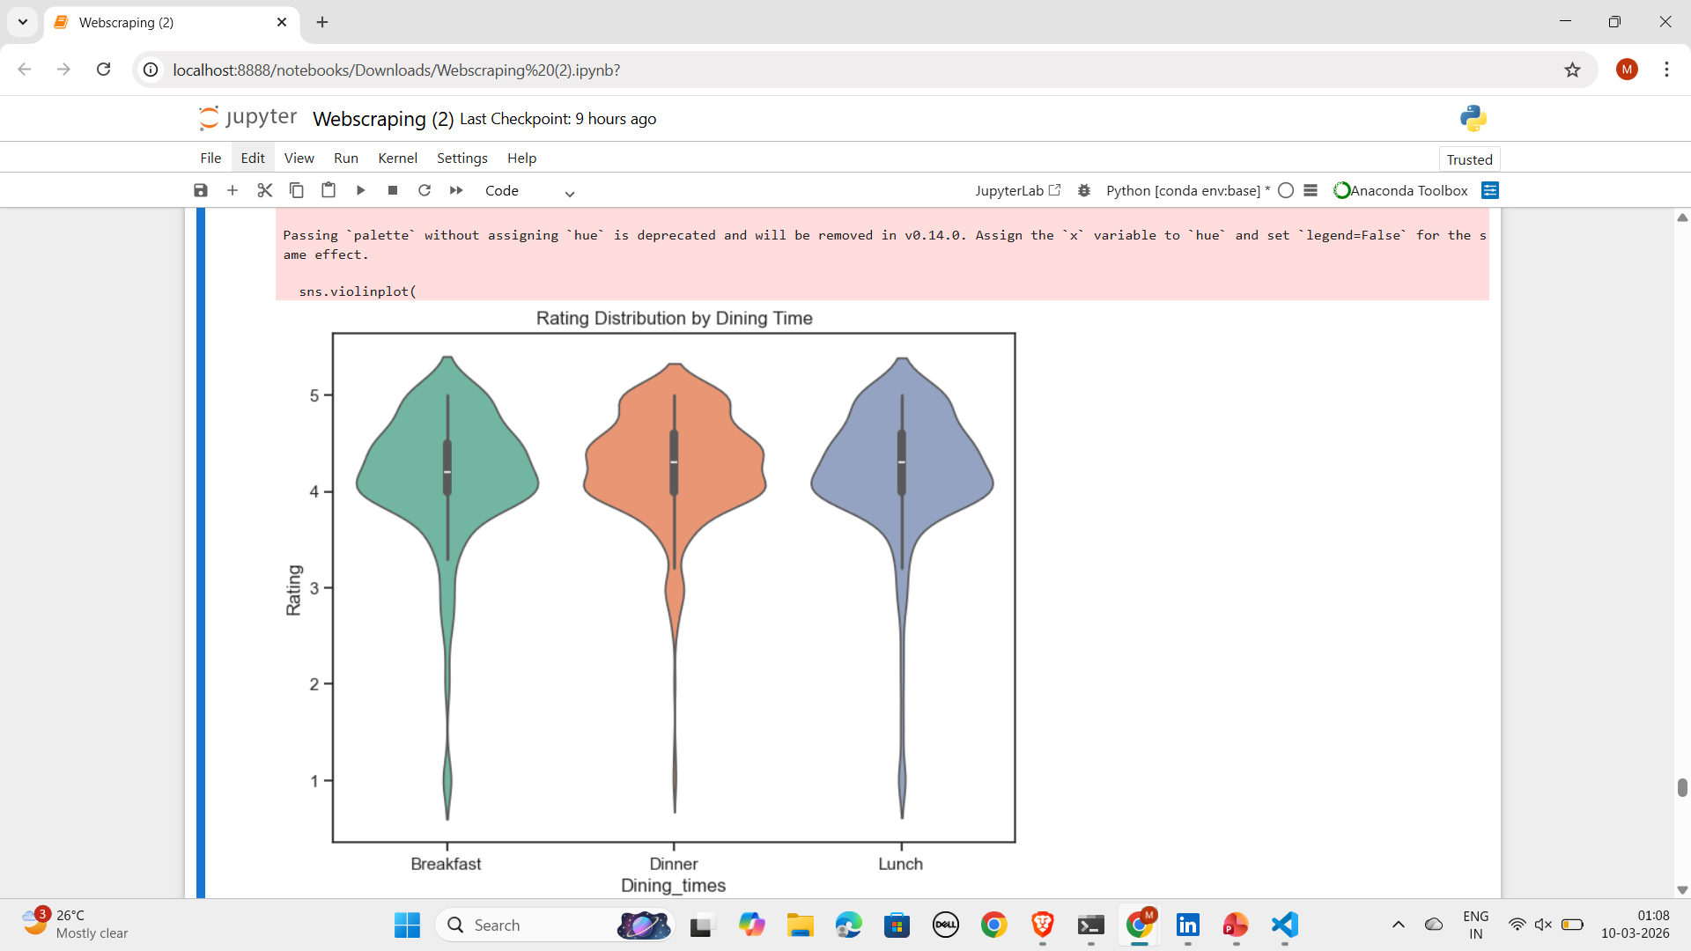
EDA - Bivariate analysis:
The violin plot shows the distribution of restaurant ratings across different dining times: Breakfast, Dinner, and Lunch.
Ratings for all dining times are mostly concentrated between 4.0 and 4.5, indicating generally high customer satisfaction.
Dinner and Lunch appear to have slightly wider distributions, suggesting a larger variety of restaurants and rating experiences during these times.
Breakfast shows a slightly narrower distribution, meaning ratings are more consistent.
18

Slide 19
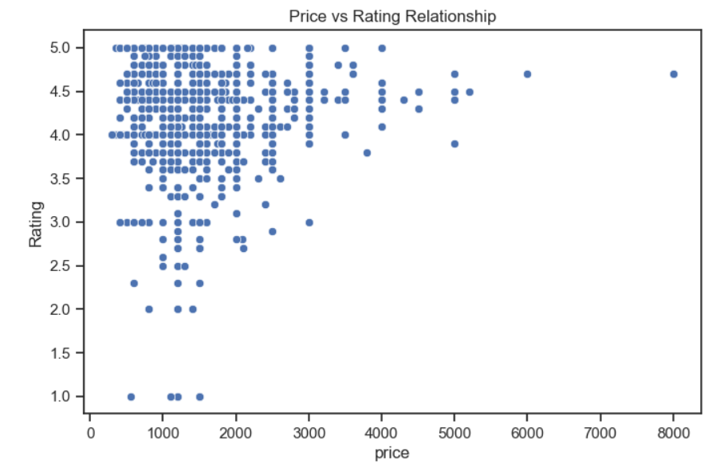
EDA - Bivariate analysis:
The scatter plot shows the relationship between restaurant price and customer ratings.
Most restaurants are clustered in the ₹800 – ₹2500 price range.
Ratings for the majority of restaurants fall between 3.5 and 4.5.
Only a few restaurants have prices above ₹4000, indicating that premium restaurants are relatively rare.
Some lower-priced restaurants also receive high ratings, showing that affordability does not necessarily mean poor quality.
19

Slide 20
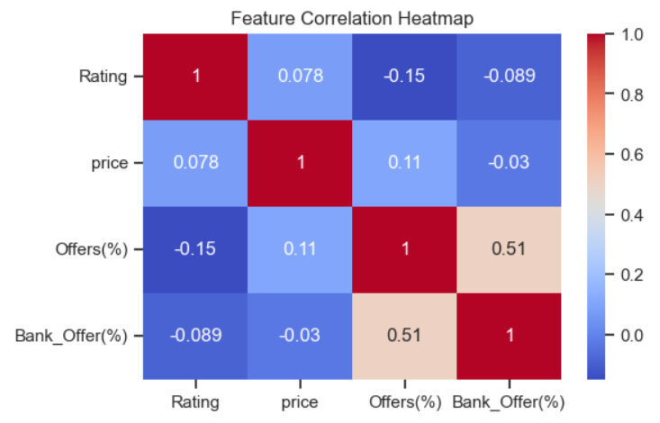
EDA - Multivariate analysis:
The heatmap shows the correlation between Rating, Price, Offers (%), and Bank Offers (%).
The correlation between Price and Rating is very weak (~0.08), indicating that expensive restaurants do not necessarily receive higher ratings.
Offers (%) and Bank Offers (%) have a moderate positive correlation (~0.51), meaning restaurants that give one type of discount often provide additional promotional offers.
Offers (%) have a slight negative relationship with Rating (~ -0.15), suggesting highly rated restaurants may rely less on discounts.
The relationship between Price and Offers is very weak (~0.11), indicating that discounts are not strongly tied to restaurant pricing.
20

Slide 21
Conclusion:
This project analyzed restaurant data collected through web scraping from the EazyDiner website. The analysis shows that most restaurants fall within a mid-range price category, typically between ₹800 and ₹2500. Customer ratings are generally high, with most restaurants receiving ratings between 3.5 and 4.5, indicating good customer satisfaction. The results also reveal that restaurant price does not strongly influence ratings, suggesting that factors such as food quality, service, and overall dining experience play a more important role. Additionally, moderate promotional offers such as 10–20% discounts are the most common, and pricing varies across cities, with Delhi and Mumbai having higher average restaurant prices compared to Hyderabad and Chennai.
21

Slide 22
Experience & Challenges
During this project, valuable hands-on experience was gained in web scraping, data cleaning, and exploratory data analysis using Python libraries such as BeautifulSoup, Pandas, Matplotlib, and Seaborn. One of the key challenges was handling missing or inconsistent data while extracting information from the website. Another challenge involved ensuring that all scraped data lists had equal lengths before creating the final dataset. Additional preprocessing techniques, including regular expressions and data transformation, were used to clean and structure the data effectively.
22

Slide 23
Future Scope
This project can be further expanded by integrating data from multiple restaurant platforms such as Zomato, Swiggy, or TripAdvisor to build a more comprehensive dataset. Advanced analysis could include machine learning models to predict restaurant ratings or pricing trends. Additionally, the project can be enhanced by developing an interactive dashboard using tools like Power BI, Tableau, or Streamlit, allowing users to explore restaurant insights dynamically. Incorporating customer reviews and sentiment analysis could also provide deeper insights into customer preferences and restaurant performance.
23

Slide 24

THANK YOU
24

